Slide 1
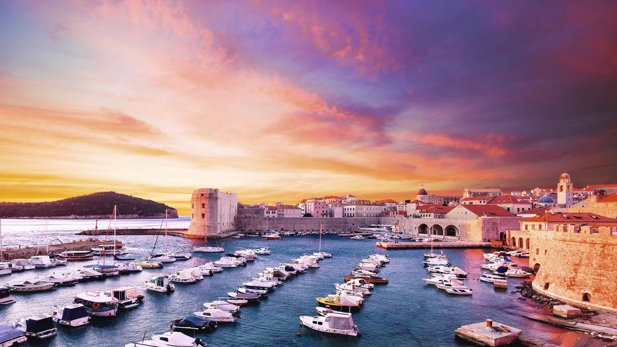
Elementary school Lapad
Elementary school Lapad
Dubrovnik, Croatia
Dubrovnik
Croatia

Slide 2
Who are we?
We are an elementary school founded in 1944./45. With our district school Montovjerna we have:
43 classes
911 pupils
87 employees
We are proud members od Magic Values Erasmus + project ☺

Slide 3
In our school we…
Highlight the successful implementation of education for human rights, civic responsibility and democracy, cooperation between students, teachers and parents.
implement programs and the preservation of cultural heritage (through artistic, literary drama workshops).

Slide 4
Our School with its activities and results is recognized in our community, at the county, regional and national level.
From 2000. it is included in the UNESCO schools network
School was also granted the status of the European Eco Schools and Green Flag

Slide 5
Little bit about Dubrovnik
It is the pearl of the Adriatic coast visited by thousands of tourist each year
Famous by its walls and fortresses
Our patron is Saint Blaise which we celebrate on February 3rd
In the history Dubrovnik was a Republic (status was achieved by the 15th century)
The Dubrovnik Republic entered its golden age in the 16th century, at a time when the power and glory of the Venetian Empire was on the wane. Its prosperity was based on maritime trade

Slide 6
The catastrophic earthquake of 1667 brought the Dubrovnik Republic into a critical period, where it fought for its survival and political independence
Napoleon dissolved the Dubrovnik Republic in 1808.
in 1815, the Dubrovnik region was joined to the other parts of Dalmatia and Croatia

Slide 7
Following the Republic of Croatias declaration of independence and subsequent Serbian aggression on Croatian territory, Dubrovnik was attacked in October of 1991. The Serbians and the Montenegrins aimed to conquer and destroy the region, attacking with a destructive force that had never been seen so far. The Dubrovnik region was occupied and significantly devastated. In the 8-month siege, the city itself was repeatedly bombarded. The most brutal destruction occurred on December 06th, 1991.

Slide 8
Today, the war-devastated cultural heritage of Dubrovnik has been repaired for the most part
We hope nothing similar will ever happen again
We hope you will enjoy every minute of your visit when you come here ☺

Slide 9
The view from above – Old Town

Slide 10
Old Town and the main street called Stradun

Slide 11
Cable car driving

Slide 12
Beautiful beaches

Slide 13
Dubrovnik bridge

Slide 14
Our school ☺

Slide 15
Early in the morning

Slide 16
Mosaic of Ivo Dulcic in the school hall

